Slide 1
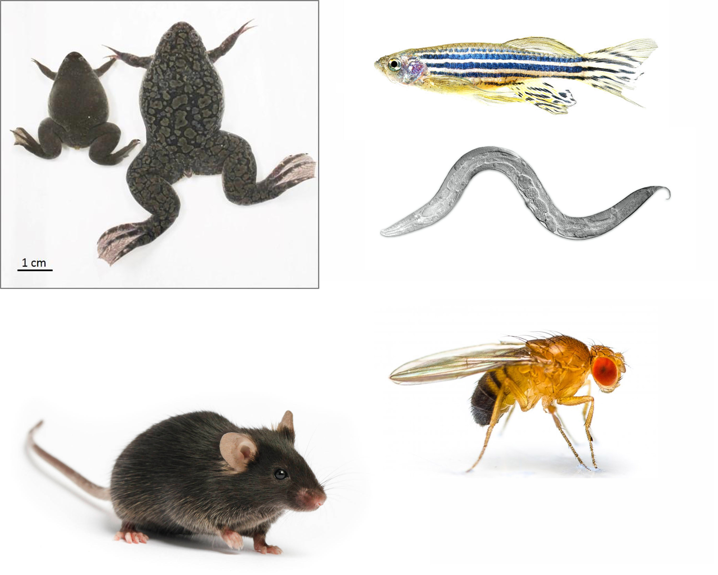
Developmental and Cell Biology Major
Developmental biology – derived from embryology – the study of how the zygote gives rise to the organism
  Developmental biology today encompasses embryology, genetics, evolutionary biology, cell biology, cancer biology, neurobiology and systems biology.
  Stem cell biology and regenerative medicine are among hottest new areas of developmental biology
Cell biology – the study of the structural functional and biological properties of cells, the smallest units of life
  Transport, adhesion, signaling, metabolism, motility, cancer, etc
Modern tools are key enabling technologies:
  Genomics
  Epigenetics
  Microscopy (confocal, two-photon, light-sheet, super-resolution)
  Single cell methods

Slide 2
Developmental and Cell Biology
Research areas in the Department
  https://devcell.bio.uci.edu/research/research-areas/
  Cancer cell biology
  Developmental genetics
  Gene-environment interactions
  Molecular signaling
  Neurobiology
  Organelle biology
  Stem cell biology
  STEM education
  Systems Biology
Engaging in BioSci 199 research is one of the best things you can do to further your career goals (Med school, grad school, etc.)

Slide 3
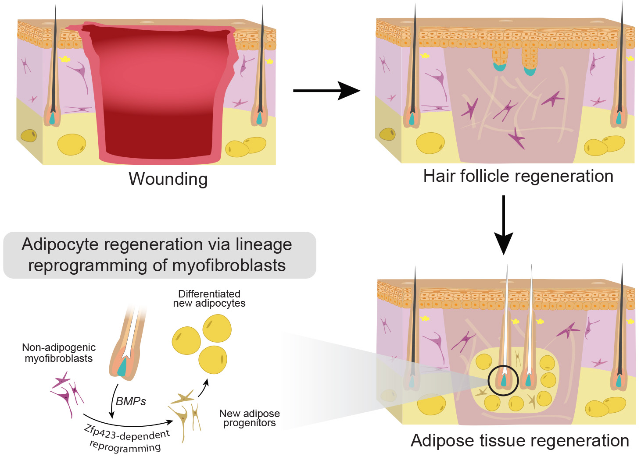
Developmental and Cell Biology major
Max Plikus lab – Mechanisms of regeneration and stem cell control
  Scar-less wound healing

Slide 4
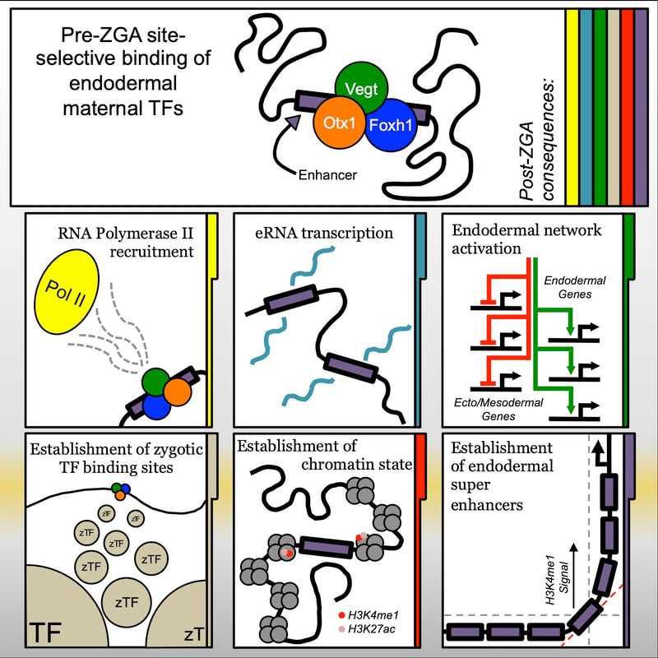
Developmental and Cell Biology major
Ken Cho lab – systems biology of embryogenesis

Slide 5
Developmental and Cell Biology major
Blumberg lab – gene environment interactions in development
How are the effects of environmental exposures transmitted to future generations?

Slide 6
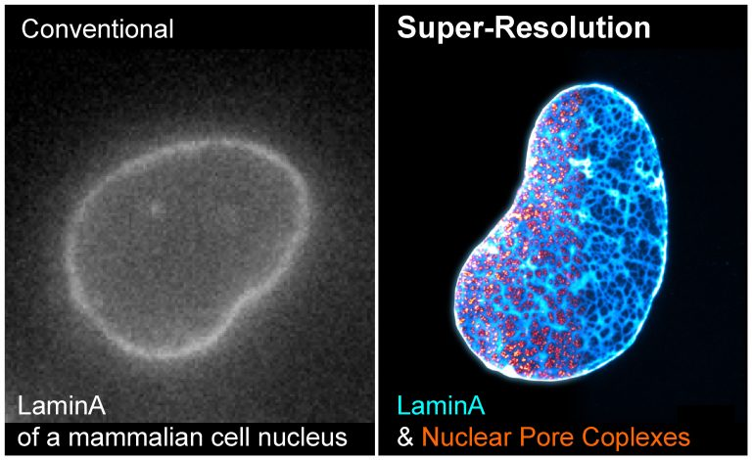
Developmental and Cell Biology major
Xiaoyu Shi lab – How do cells drive developmental mechanisms across all scales?

Slide 7
Why major in Developmental and Cell Biology?
What do I get?
  More in depth training in Developmental and Cell biology
  Can replace 1 upper division lab with Excellence in Research
  Close interactions with faculty advisors who provide advice and career counseling in addition to BioSci advisors.
    Specific to your career choices and requirements
  Recognition of specialization on transcript
  Department recognition/luncheon, sashes, gifts.
D114 - Informal group seminar for majors (spring, including lunch)
  Build camaraderie, share research experience, hone presentation skills, personal interactions with guest speakers selected by students
In 2022 we had the following speakers in D114
  Transitioning from academia to industry (Dr. Amanda Janesick)
  Graduate school admissions (Drs. Sha Sun and Ken Cho)
  Careers in NGOs (Dr. Alexis Temkin, Environmental Working Group)
  Using science to advocate for healthy environment (Kim Konte, NTN)
  Genetic counseling as a career (Pamela Flodman – Director, UCI GC)
  Careers in FDA and public health (Renee Padiernos)
  Medical school admissions (Dr. Ellena Peterson)

Slide 8
Developmental and Cell Biology major
Requirements for admission
  At least junior standing (applications accepted in Spring)
  3.0 GPA (in BioSci courses) (but flexible depending on circumstances)
  Demonstrated interest in subject
  BioSci 199 strongly encouraged (we can help place you)
  Strong interest in a biomedical research career is beneficial
Required courses
  93-99, D103, D104, D145 (winter)
  1 Upper division cell biology (menu of 5)
  1 upper division developmental biology (menu of 3)
  3 electives from a large list of possibilities
  100L, D111L, 1 upper division lab (but can petition Excellence)
  Approval by the Department advisors
For more information please contact
Bruce Blumberg (blumberg@uci.edu) 824-8573
Ken Cho (kwcho@uci.edu) 824-4067

